Slide 1
Blogora
Presented by: Talha Ahmad

Slide 2
Motive of Blogora
Make portfolio stronger
Practice workflow between frontend and backend
Understand architecture and business rules
Build teamwork habit

Slide 3
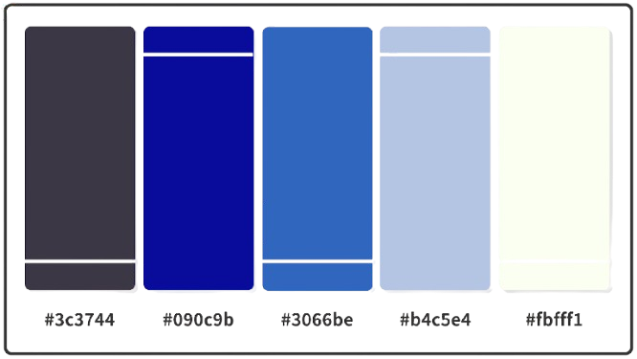
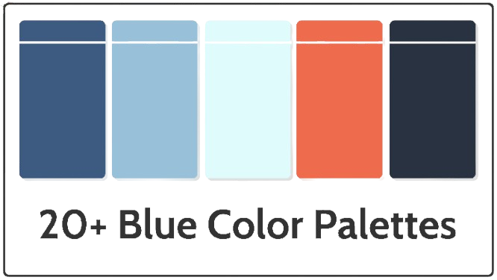
Dark Theme
Light Theme
Themes for Blogora

Slide 4
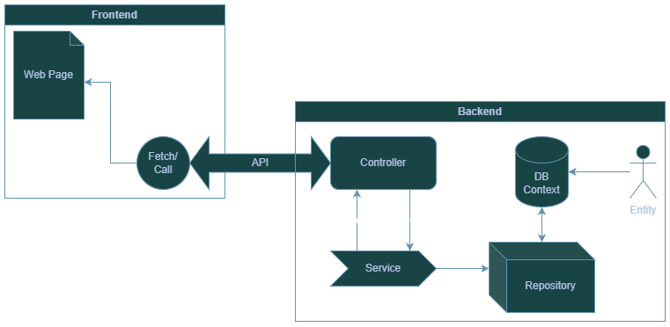
Architecture of Blogora

